Slide 1
DATA 55100– Unsupervised Machine Learning
Dr. Sam Abuomar
DATA 55100– Unsupervised Machine Learning Features Extraction Dr. Sam Abuomar
Dept. of Engineering, Computing and Mathematical Sciences

Slide 2
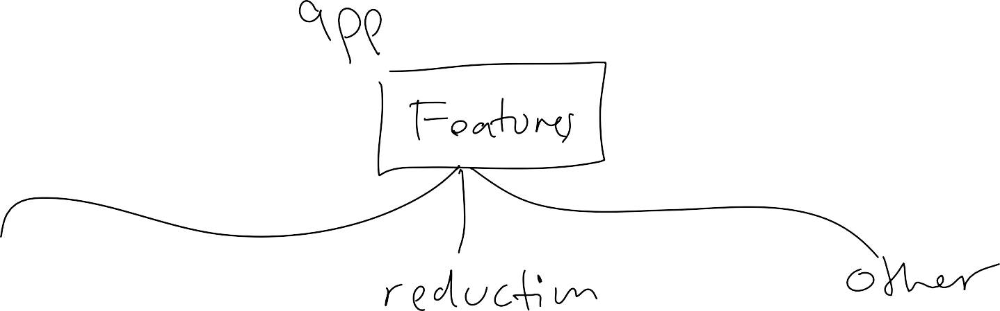

Slide 5
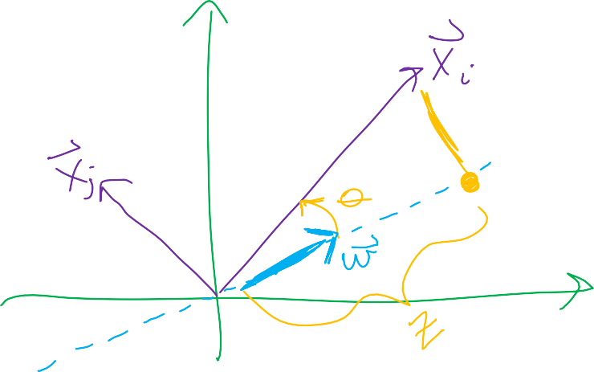

Slide 6
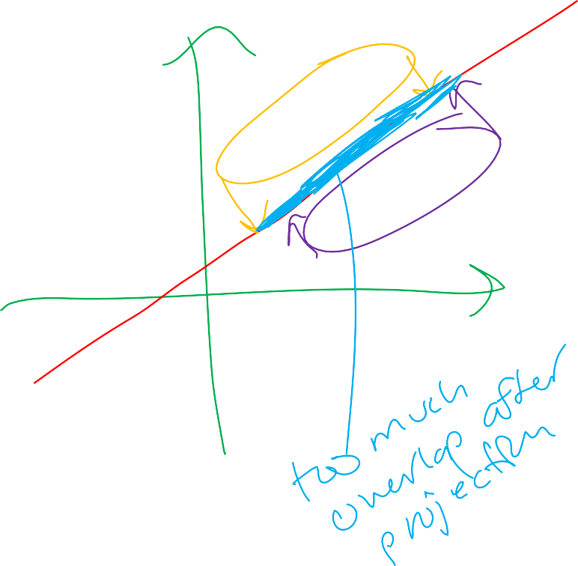
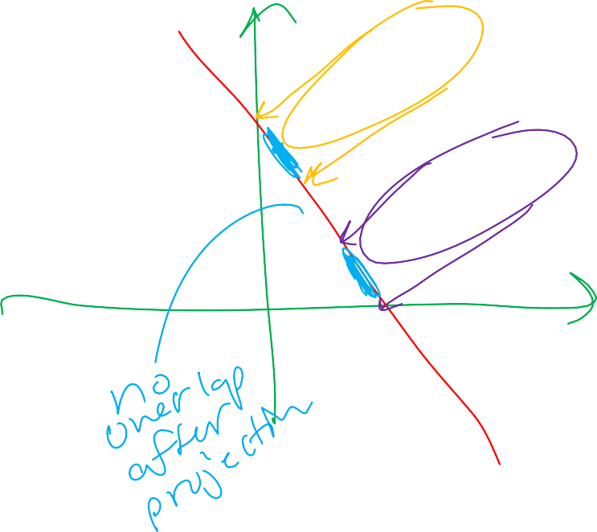

Slide 7
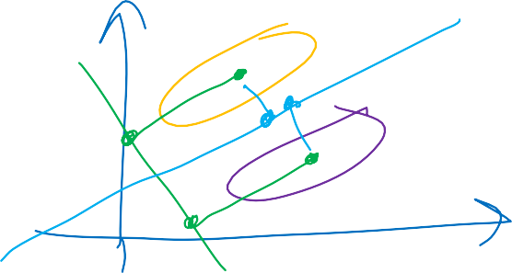

Slide 12
Curse of Dimensionality
Bellman coined in 1961
– Refers to problems associated with multivariate data analysis as the dimensionality increases
Lets gain an intuitive understanding by
considering a really simple 3 class example

Slide 13

Simple Example (Part 1)
Simple approach would be to
Divide feature space into bins
Compute ratio of examples for each class & bin
For new example, find its bin and choose the
predominant class in that bin

Slide 14
Simple Example (Part 2)
BUT
Too much overlap for the classes
So, lets incorporate a second feature to help improve the classification rate, right?

Slide 15
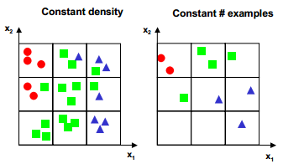
Simple Example (Part 3)
Lets preserve granularity of each axis, which raises the number of bins from 3 (in 1D) to 3^2=9 (in 2D)
Decision
Do we maintain the density of examples per bin or do we keep the number of examples we used for the 1D case?
Choosing to maintain the density increases the number of examples from 9 (1D) to 27 (in 2D)
Choosing to maintain the number of examples results in a 2D scatter plot that is very sparse

Slide 16
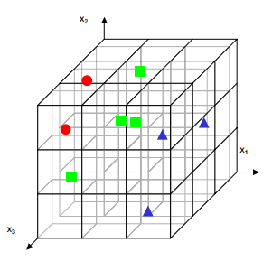
Simple Example (Part 4)
Moving to 3D makes the
problem even worse
Number grows to 27
For same density of examples the number of needed examples becomes 81
For same number of examples, the 3D scatter plot is almost empty
Approach to divide the sample
space into equally spaced bins
– Really inefficient

Slide 17
Curse of Dim. – Few General Remarks (1)
As dimensionality increases, volume of space increases
(fast) and the available data becomes sparse
Exponential growth in # of examples required to maintain a sampling density
Problematic - methods that require statistical significance
Exponential growth in complexity of target function (a density estimate) with increasing dimensionality
Function defined in high dimensional space is likely to be much more complex than a function defined in a lower dimensional space, and those complications are harder to discern – Friedman
i.e., more complex target function requires denser sample points to learn it well!

Slide 18
Curse of Dim. -Few Genera Remarks Organizing and searching data often relies on detecting areas where objects form groups with similar properties; in high dimensional data however all objects appear to be sparse and dissimilar in many ways which prevents common data organization strategies from being efficient
Adding more features can increase noise, and
hence the error
Heavy resource implications (memory, computation, etc.)

Slide 19
Curse of Dim. – Another View
General excuse for one not dealing with
high-dimensional data
Honestly, not yet completely understood yet
– jury is still out on this one

Slide 20
Feature Selection vs. Extraction
Defs.
Feature extraction
Transform existing features into lower dim. Space
We will explore
» PCA
» LDA
Feature selection
Select a subset of existing features without transform
Different options
» Exponential algorithms
Exhaustive, beam search, etc.
» Sequential algorithms
Seq. forward selection, backward selection, floating search, etc.
» Randomized algorithms
Simulated annealing, genetic algorithms, etc.

Slide 21
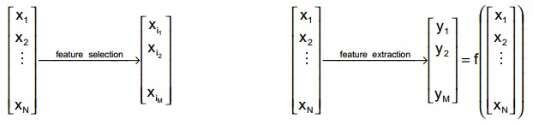
Feature Selection vs. Extraction

Slide 22
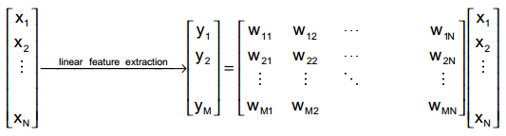
Dimensionality Reduction
In general, optimal mapping is non-linear
manifolds
However, linear is the common practice
Will focus on this category in this class
feature

Slide 23
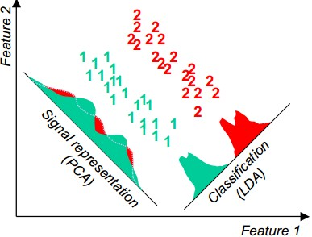
PCA vs. LDA
Two common techniques

Slide 24
Principal Component Analysis (PCA)
“information packing”
aka Karhunen-Loeve Transform
Goal is to de-correlate the data
Want features that are mutually uncorrelated in order to avoid information redundancies

Slide 25
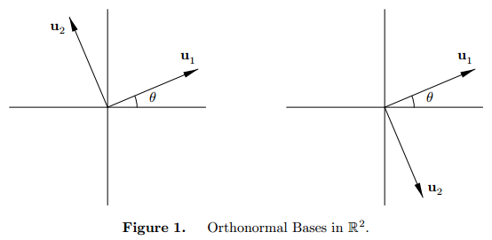
Principal Component Analysis (PCA)
Let x be an N-dimensional vector, represented
as a combination of orthonormal basis vectors

Slide 26
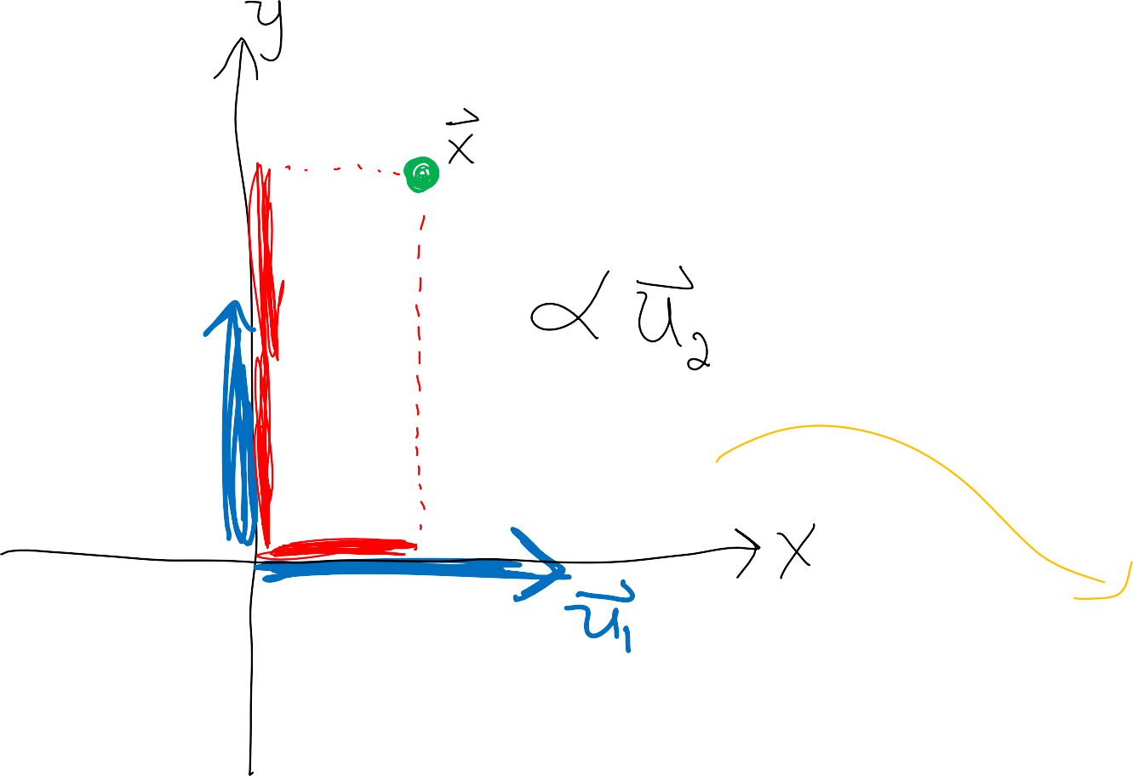
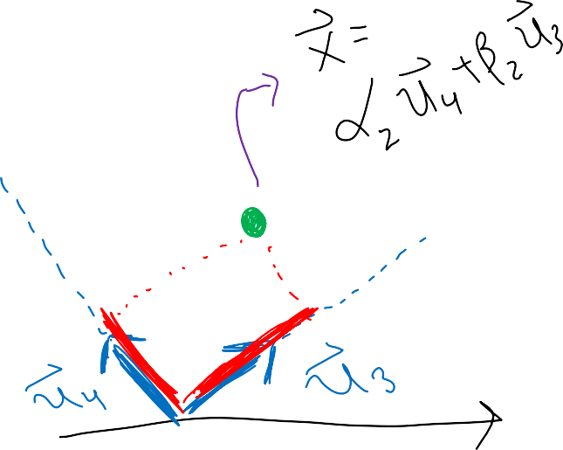
Principal Component Analysis (PCA)

Slide 27
Principal Component Analysis (PCA)
Let x be an N-dimensional vector, represented
as a combination of orthonormal basis vectors
Suppose we represent x using only M (M<N) of
the basis vectors

Slide 28
Principal Component Analysis (PCA)
Error
Can measure this representation error by the
mean-squared magnitude of delta x
Goal is to find the basis vectors and constants that
minimize the overall mean squared error

Slide 29
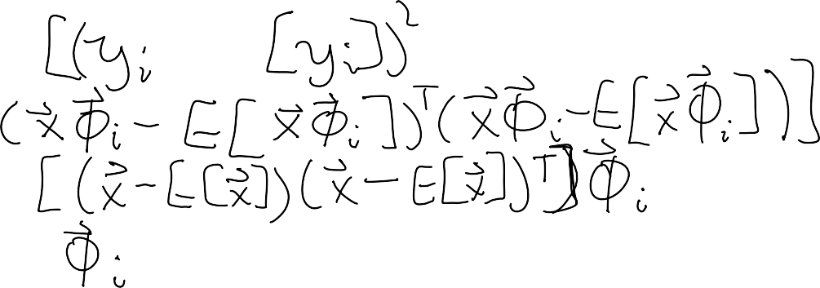
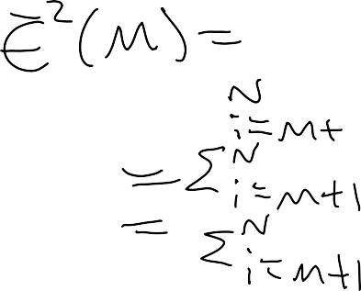
Principal Component Analysis (PCA)
To find optimal values of b’s
Will replace discarded dimensions by their
expected value – intuitive result
MSE can therefore be written as:

Slide 30
Principal Component Analysis (PCA)
Seek solution that minimizes the last expression,
subject to orthnormality constraint
So – find eigenvalues and vectors of Sigma_x
PCA - aka Karhunen-Loeve transform

Slide 31
Principal Component Analysis (PCA)
Can express SSE as
To minimize this measure, want smallest eigenvalue ones
Therefore, to represent x with minimum MSE, we choose the eigenvectors corresponding to the largest eigenvalues
– i.e., maximal spread

Slide 32
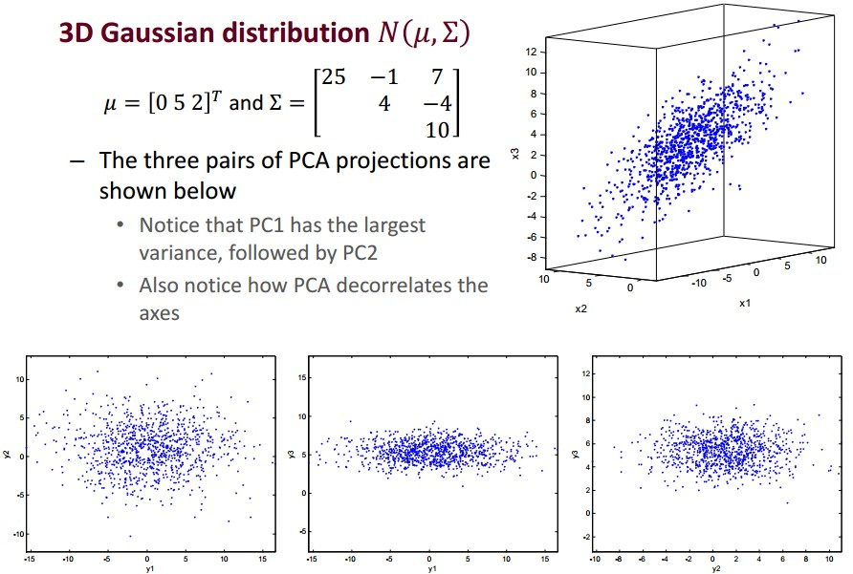
PCA Example 1a

Slide 33
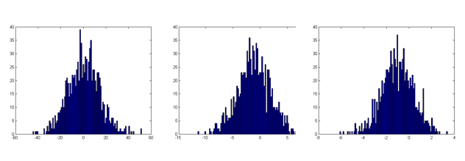
PCA Example 1b

Slide 34
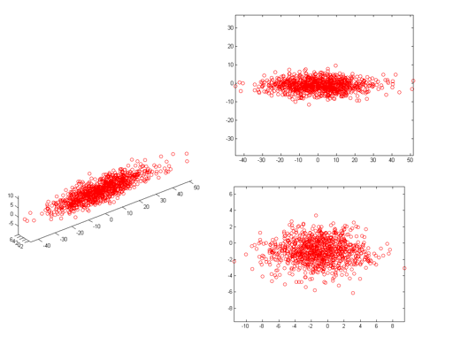
PCA Example 1c

Slide 35
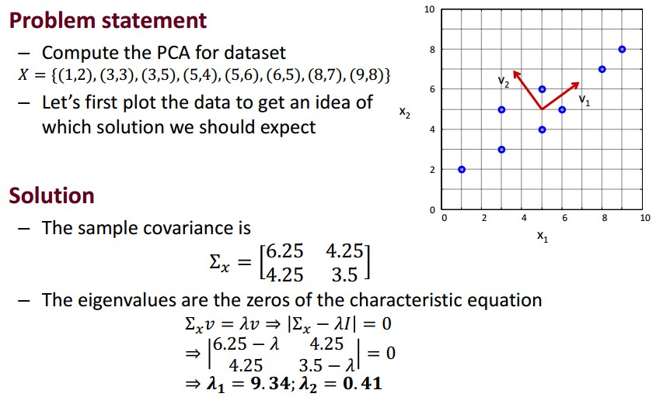
PCA Example 2a

Slide 36
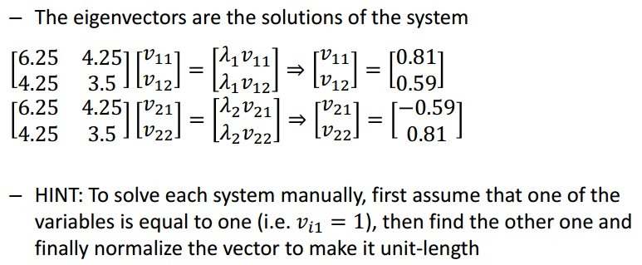
PCA Example 2b

Slide 37
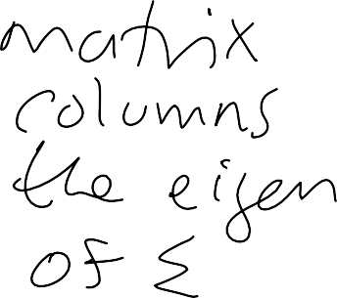
Another Perspective

Slide 38
Another Perspective

Slide 39
Another Perspective

Slide 40
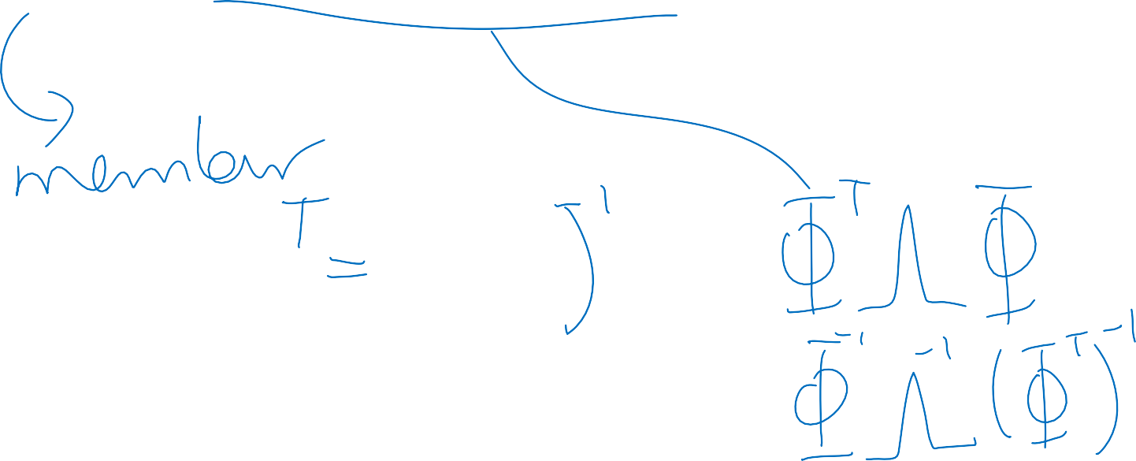
Another Perspective

Slide 41
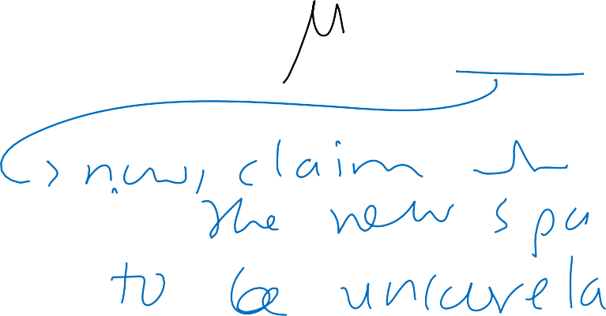
Another Perspective

